Slide 1

Customer Retention
What is this and Why is this required for every Organization?

Slide 2
What is Customer Retention?
Customer retention is the ability to keep customers coming back to your store or website to create repeat business and investment.
Keep your Customer engaged and Build Trust.
Customer Retention ensure customer loyalty.
It is the process of engaging existing customers to continue buying products or services from your business.
Customer Retention is the percentage of new customers retained. You want to retain a customer. Retention is probably the most important metric for an online business.
In Other Words Customer Retention means
“to maintain existing customers”

Slide 3
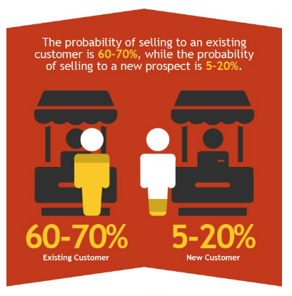

It’s different from customer acquisition or lead generation because you have already converted the customer at least once.
Your probability of selling to an existing customer is at least 40 percent more likely than converting someone who has never bought from you before.

Slide 4

Customer Retention (CR) Its not a tool its an Art

Slide 5
What are the benefits of CR?
Retained customer tend to buy other services from the same company
Retained customer are known to be less price/cost effective
Positive publicity - Free Marketing 24 x7
The probability of selling to an existing customer is 60 – 70%
While the probability of selling to a new customer is 5-20%
Decline Migration rate
Increase the value of each sale for each customer
Boost referrals and strengthen customer loyalty
Experiment safely with customers who are open to change

Slide 6
Retention Tactics
Poor customer service brings 70% of customer loss
Always ask for feedback from customer
Listen first, understand and then talk
Bring your customers together
Give priority and importance to customers always
Find out what makes customer to stay or leave
Analyze customer feedback to gain valuable insights and ensure that right person hear it.

Slide 7
Lets Analyze customer feedback to gain some useful insights

Slide 8
What Data we have?
We have customers feedback for e-Commerce websites
> Total 269 customers reply over 70 questions each
Lets do Exploratory Data Analysis for some useful insights

Slide 9
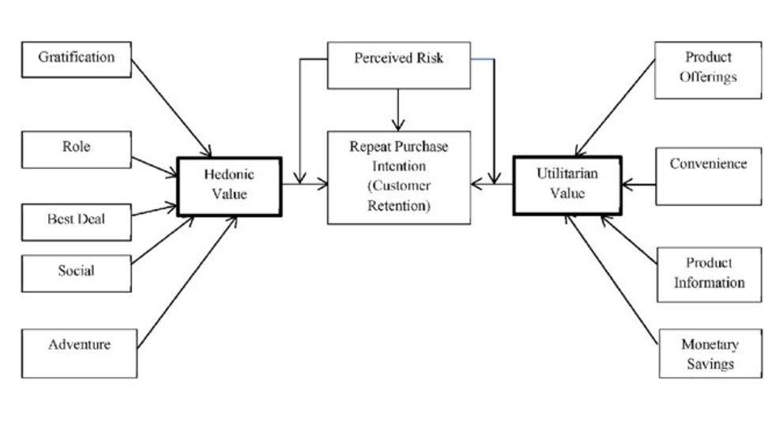
Some Key points to Retain Customers
We will analyze our data
In accounts to these key
points
Data is about to 5 Companies
Amazon
Flipkart
Myntra
Paytm
SNapdeal

Slide 10
Hedonic Values
Hedonic shopping value reflects the value received from the multisensory, fantasy and emotive aspects of the shopping experience
Hedonic goods are multisensory and provide for experiential consumption, fun, pleasure, and excitement. It comes with good feeling.

Slide 11

Who is our potential customer?
> Females are the
Potential customer
67.29%
21 – 50 Years are potential age who covers
85% sales

Slide 12
Top 10 Cities for e-commerce

Slide 13
Shopping Pattern

Slide 14
How they do shopping?

Slide 15
How Customer reached to online website?
Customers are somehow know what they need so that they search on search engine like Google

Slide 16
Customer habit on ecommerce
Female spend more time on ecommerce websites and sometimes abandon the shopping cart

Slide 17
Website content

Slide 19
Hedonic Values

Slide 20
Online retailer preferred:

Slide 21
Easy to use Platform
Conclusion:
Amazon platform is first choice where online shopping is easy with speedy order delivery
Flipkart platform is second choice of customers
Myntra secured the 3rd place in customers choice
Snapdeal is on 4th position
Paytm is the 5th choice

Slide 22
Product Availability:
Conclusion:
1. Amazon have variety of products with complete ,relevant information
2. Flipkart is on 2nd choice
3. Myntra is on 3rd Choice
4. Snapdeal secured 4th position
5. Paytm is on 5th position in Product availability category

Slide 23
Platform Technical performance
Conclusion:
Amazon is technically best platform as per customer choices
Flipkart is on the 2nd position in this category
Paytm secured 3rd position on platform stability
Myntra is on 4th position
Snapdeal is on 5th position

Slide 24
Privacy of Customer
Conclusion:
Amazon again on Top position in Customer privacy
Flipkart is on 2nd position
Myntra secured 3rd position on customer privacy matter
Snapdeal is on the 4th position
Paytm somehow not able to gain customers trust

Slide 25
Performance during promotion, sales period
Conclusion:
However, Amazon is most favorite and popular website for
ecommerce but during sales period time performance is not
much good.

Slide 26
Which of the Indian online retailer would you recommend to a friend?
Conclusion:
Clearly, Amazon is leading
In most of the categories to
Customers first recommendation.

